Slide 1
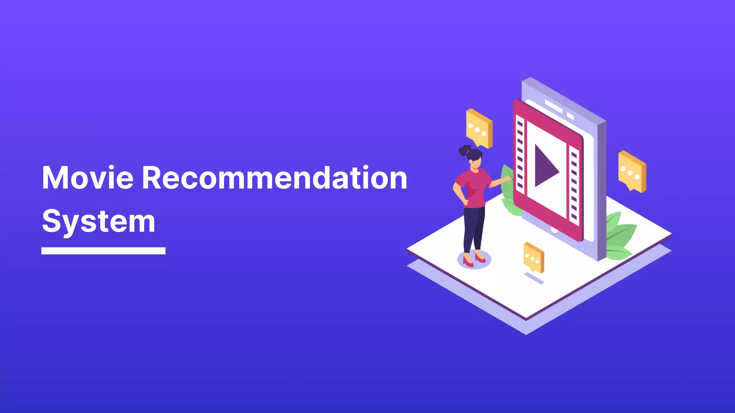
Non-Technical Presentation
Prepared by: Group 1

Slide 2
Project Overview
Developed a recommendation system using the MovieLens 32M dataset.
Goal: Suggest top 5 movies to users based on past ratings.
Models used: KNNBasic (baseline), SVD and a Hybrid model.

Slide 3
Business Understanding
Users face decision fatigue due to too many content choices.
Streaming platforms benefit from recommending relevant content.
Improves user satisfaction, engagement, and retention.

Slide 4
Data Overview
MovieLens 32M dataset: 200K users, 87K movies, 32M ratings.
Features used: UserId, movieId, rating, movie title and timestamp.
Filtered to active users (≥20 ratings) and movies (≥50 ratings).

Slide 5
Data Preparation
Data cleaning and inspection which involved checking for missing values, duplicate entries and invalid ratings.
Removed noise and filtered low-activity users/movies.
Prepared Surprise-compatible format for modeling.

Slide 6
Exploratory Analysis
Found users favor highly-rated movies in Drama, Comedy, and Thriller genres.
Active users and popular movies provide strong signals for recommendations.

Slide 7
Modeling Approach
KNNBasic: item-item collaborative filtering using cosine similarity.
SVD: matrix factorization for latent preferences.
Evaluation: 80/20 train-test split with RMSE and MAE metrics.

Slide 8
Model Performance
KNNBasic RMSE: 0.8844 | MAE: 0.6753
SVD RMSE: 0.8368 | MAE: 0.6395 (better performance)
SVD chosen for deployment due to improved accuracy.

Slide 9
Top Recommendations (User 555)
Alien (1979) — Predicted Rating: 4.55
Raiders of the Lost Ark (1981) — Predicted Rating: 4.53
A Clockwork Orange (1971) — Predicted Rating: 4.52
Star Wars: Episode V (1980) — Predicted Rating: 4.50
Terminator 2: Judgment Day (1991) — Predicted Rating: 4.46

Slide 10
Hybrid Filtering
Combined SVD with genre-based cosine similarity.
Addressed cold-start issues for new users.
Blended scores with alpha=0.7 (70% CF, 30% content-based).

Slide 11
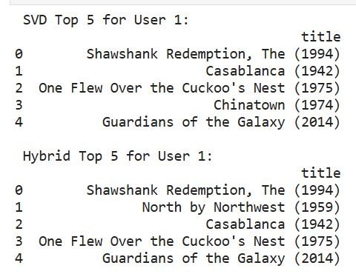
Comparing SVD and Hybrid models Top 5 Recommendations for a User
The hybrid model successfully retained some of the top collaborative picks while introducing new recommendations that align closely in genre

Slide 12
Business Impact & Insights
Deploy SVD model into a web or mobile app backend.
Gather user feedback and retrain as data grows.
Explore hybrid methods using genres and tags.

Slide 13
Next Steps
Deploy model to flag high-risk customers weekly.
Integrate predictions into CRM for personalized retention actions.
Continue refining the model with new data.

Slide 14
Appreciation
We would like to thank MovieLens team for dataset access which made these analysis possible.
Questions?
We would love to hear your take on this! Please feel free to get in touch.
Contact Information:
Name: James Gatonye
LinkedIn: https://www.linkedin.com/in/james-gatonye-b5144991/

